Slide 1
8.5.2 Underlying Asset Pays Dividends
04/18 邢子謙

Slide 2
目標
Prove that it is not optimal to exercise an American call on this asset except possibly immediately before a dividend payment.

Slide 3


建構付息當下之股價

Slide 4
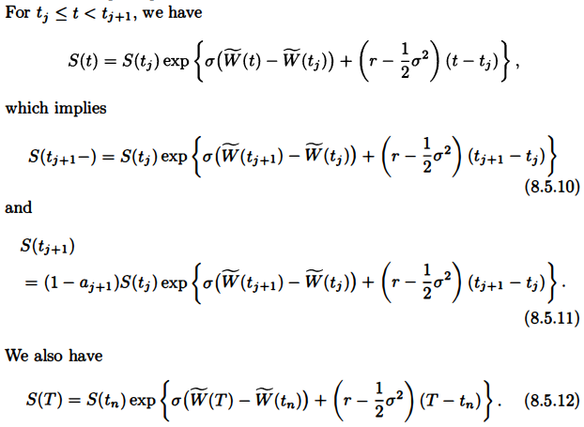
建構股價之過程

Slide 5
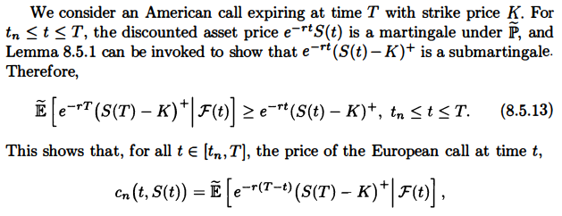



Slide 6
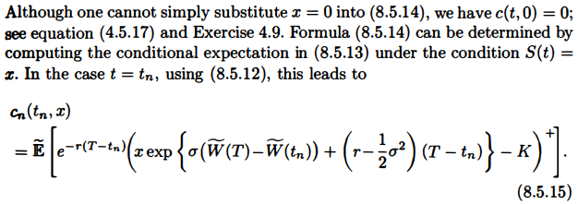




Slide 7
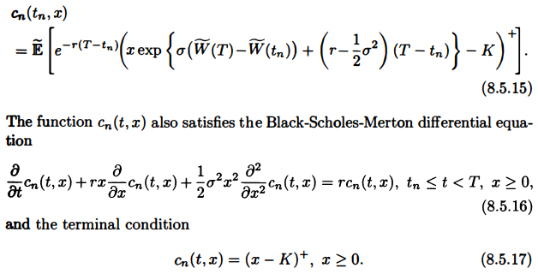

Slide 8
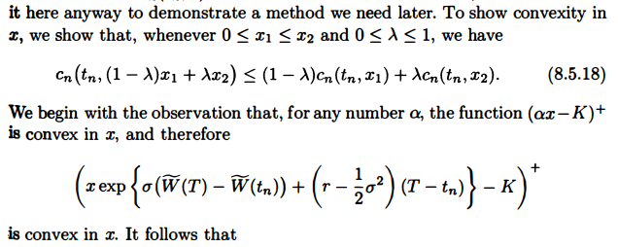
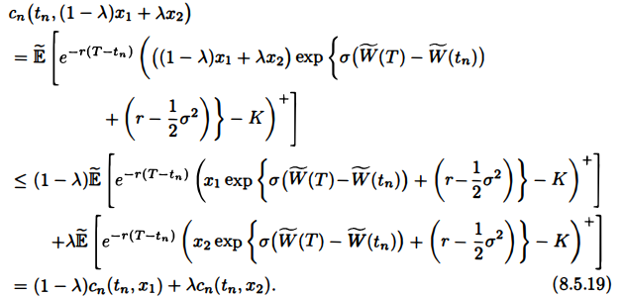

Slide 9
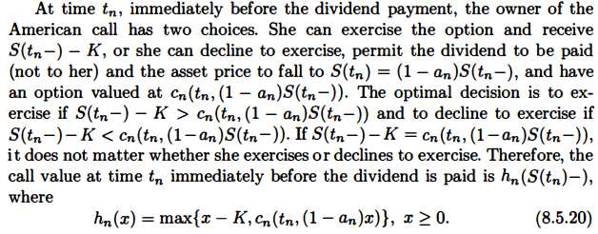

Slide 10
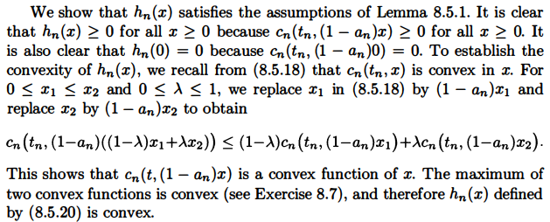

Slide 11



Slide 12


Slide 13
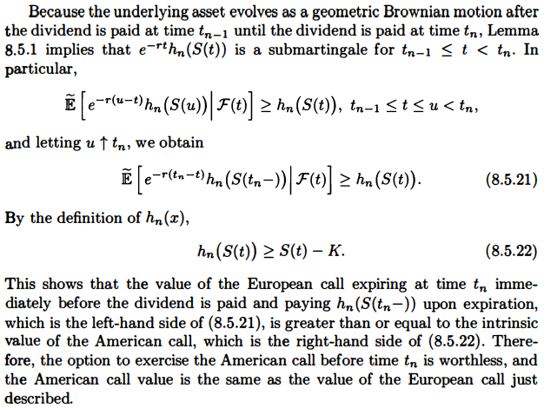

Slide 14
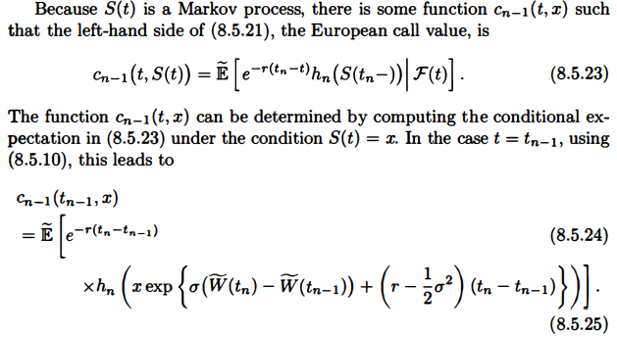


Slide 15
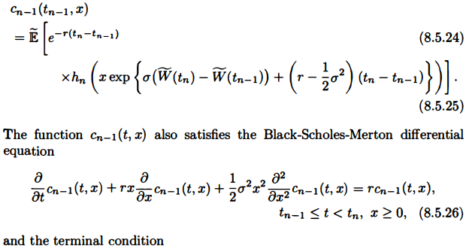


Slide 16
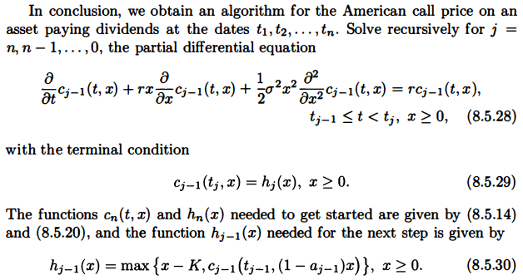

Slide 17


